Slide 1

Recycle to earn
Group 1
Leveraging blockchain technology

Slide 2
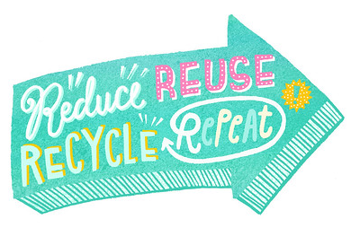
Agenda
Introduction
Current challenges
Solution overview
How it works
Benefits
Stakeholders
Impact
Technical briefing
Future development ideas
conclusion

Slide 3
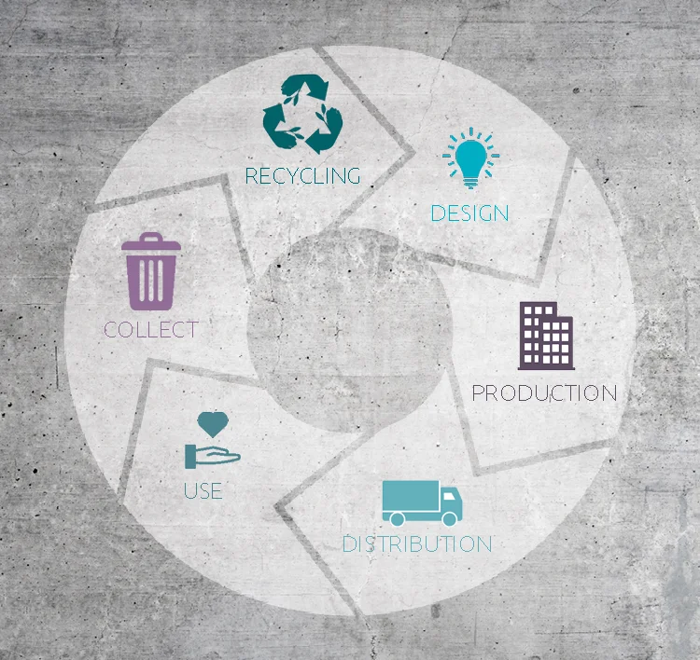
Introduction
Welcome to the “Recycle to Earn” presentation
Purpose: Deploying a blockchain token “RTK” to incentivize recycling and reward participants for their efforts
Our goal: Encourage sustainable practices and increase recycling rates

Slide 4
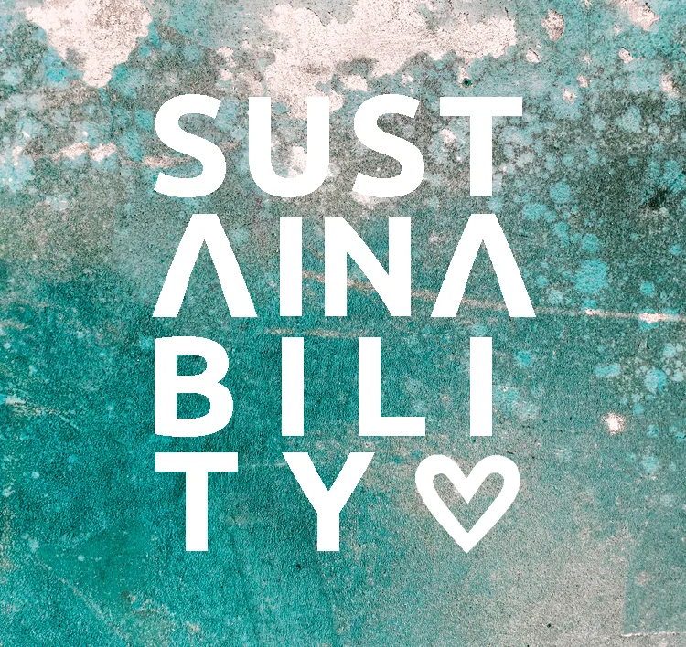


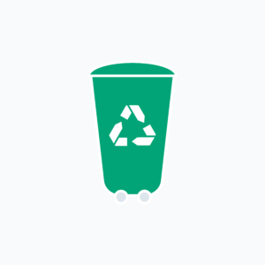
Current Challenges
Problem statement
Low recycling rates and lack of motivation among individuals
Environmental impact
Landfill accumulation, pollution, and resource depletion
Traditional recycling
Ineffective incentives and limited tracking capabilities

Slide 5
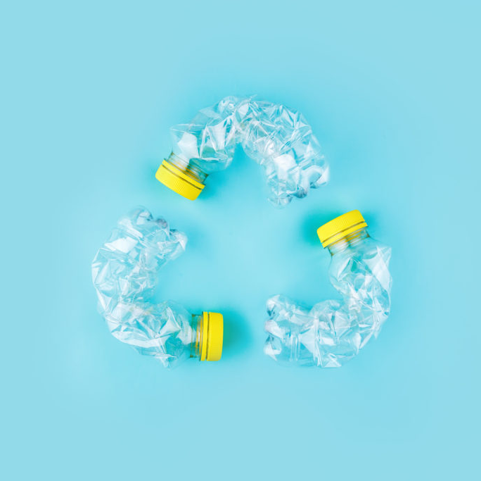
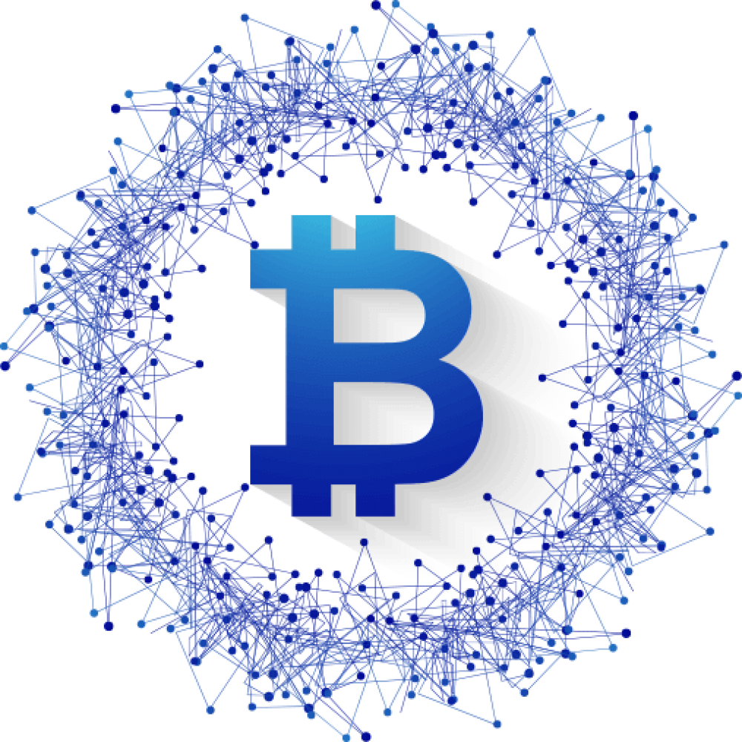


Solution overview
Blockchain technology
Transparent, secure, and immutable ledger
Token deployment
Introduce a blockchain-based token (RTK Token) system
Recycle to earn
Reward participants with RTK tokens for recycling efforts

Slide 6
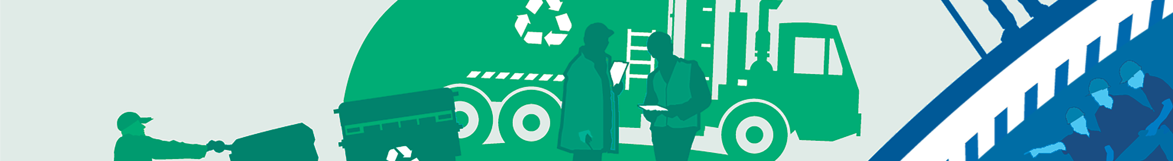
How it works
User Registration
Recycling submission
Verification process
Token distribution
Participants create an account and receive a unique digital wallet address
Users submit recyclable items at designated centers
Recycling centers verify the items and update the blockchain ledger
Verified submissions are rewarded with RTK tokens

Slide 7
Benefits
Encourages individuals to participate actively
Blockchain ensures traceability and prevents fraud
Token rewards create an interactive and enjoyable experience
Valuable recycling data collected for analysis and improvement
Incentivizing recycling
Transparent & secure
Gamification & engagement
Data insights

Slide 8

stakeholders
Participants
Recycling centers
Token holders
Environmental organizations
Individuals motivated to recycle and earn tokens
Responsible for verifying and updating blockchain records
Individuals who accumulate tokens can redeem them for various benefits
Partnerships to support and promote the program

Slide 9
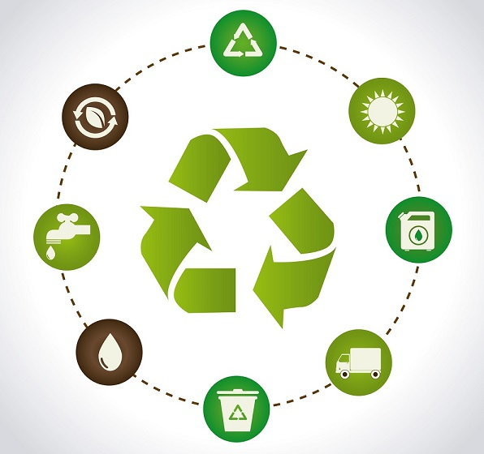


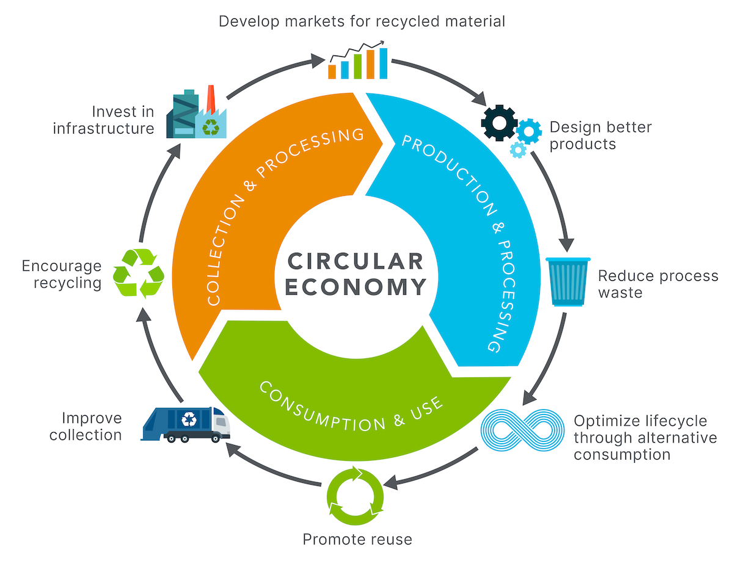
impact
Environmental benefits
Reduced waste, conservation of resources, and decreased pollution
Behavioral change
Encourages sustainable practices and raises awareness
Circular economy
Fosters a more efficient use of resources through recycling

Slide 10
Technical briefing
Used Python for creating a back-end foundation for the Recycling app.
Incorporated multiple product categories, along with their quantity-to-crypto ratios for determining how customers would be remunerated.
Built 2 layers of front-end using Streamlit for the purpose of making the front end f engaging for the customers.
Created a customized token for this recycling app under Goerli test network: RTK token
Incorporating the RTK token framework into recycling app for swapping tokens for Ethereum or USDC crypto currencies.

Slide 11
Future development ideas
Future development 1: Building the functionality for RTK tokens to be earned and traded through recycling app.
Future development 2: developing a front end using ReactJS
Benefits of ReactJS: Faster Rendering; Handy developer tools; SEO-enabled, Mobile app development.

Slide 12
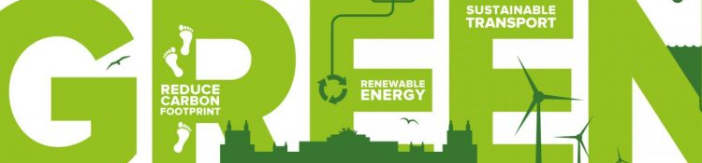
conclusion
The Recycle to Earn Program leverages blockchain technology to revolutionize recycling efforts
By incentivizing participants with tokens, we create a sustainable and rewarding ecosystem
Together, we can make a significant impact on the environment and build a greener future

Slide 13


Thank you
Alex Leonov Jill Popat Manan Wala Minh Ngguyen Ritvik Thakur

